Slide 1

ICE, Turn, Stun and Security
Session: D2-1
Tsahi Levent-Levi
Director, Product Management
Amdocs
tsahi.leventlevi@gmail.com

Slide 2
Session Presenters
Glen Gerhard
  VP Product Management
  Sansay
Karl Stahl
  CEO/CTO
  Ingate Systems
Richard Blakely
  CEO
  Influxis / XirSys

Slide 3


Slide 4

Glen Gerhard
VP Product Management
Sansay ggerhard@sansay.com

Slide 5
Interactive Connectivity Est.
Builds a candidate list for endpoints to use as available
Uses direct path, STUN or TURN paths
Direct is called Host Path
Outside NAT path is Server
TURN is called Relay Path
Candidates provided by application server for each path
Compatible with SIP endpoints at media layer
Algorithm decided on candidate directives
TURN Server
Relay
Server
Host
NAT
a=candidate:1 1 UDP 2130706431 10.10.1.11 8338 typ host
a=candidate:2 1 UDP 1694498815 192.8.2.13 45664 typ srflx raddr 10.10.1.11 rport 8338
a=candidate:3 1 UDP 6130862446 64.97.22.36 53248 typ relay
STUN Client

Slide 6
STUN Process
Endpoints generate special signaling packets for STUN Protocol
NAT maps STUN packets per normal, seen at Server
This information passed back to Client
And then passed Client to Application Server
Provided to far end device for external relay
Server Candidates usually #2 after Host
Can be blocked by NAT/Firewall depending on type
Corporate firewalls often cause issues
Firewalls becoming more restrictive.
Percentage of calls that fail varies (10-15% +/- ?)
STUN Server
Bind
Response:
Sending
lP:UDP
NAT
STUN Client

Slide 7
TURN Difficulties
Application system does not control TURN server directly
Creates a risk for DOS at media layer
Encryption keys not known by TURN server
So cannot be used for SRTP-RTP translation
So cannot be used for transcoding
Performance of media layer is not reported on call legs
May be able to get end-end data, but not per call
leg data
ICE candidate checks can add to PDD on sessions
Trickle ICE is useful but call set up is still delayed

Slide 8
More Secure Approach
Application Server
Provide endpoints with one SDP
Use media
relay to secure
and ensure path
Relay Point
RTC
Client
HTTPS
RTC
Client
Media

Slide 9
API with Media Control
Application controls media relay ports directly
Full control of relay and security on ports
Encryption keys can be passed for SRTP decryption
Relay can now be used for transcoding
SRTP to RTP; Opus to G711, G.722
Enables advanced applications such as streaming, speech req,
conferencing and recording
Permits CALEA function to be centralized
ICE candidate can provide one candidate
Reduce PDD and improve reliability
Fault tolerant designs are possible with HA hardware

Slide 10
Media Relay Trade Offs
The application needs to understand the API
Build API to be app friendly with JSEP or ROAP
Media relay adds bandwidth at the relay site
Adds cost to network build out (esp with video)
Most networks today expect this B/W usage
B/W costs low at colo sites, not true on local loop
Off net calls to SIP will generally require media relay
What feature set does your application require?
What price enhanced security and ensured connectivity?

Slide 11


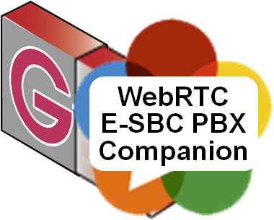
Karl Stahl
CEO/CTO
Ingate Systems info@ingate.com karl.stahl@intertex.se
Ingate’s SBCs do more than POTSoIP SIP. They were developed for standard compliant end-to-end multimedia SIP connectivity everywhere.
WebRTC is just aligned – Ingate adds Q-TURN telepresence quality and the WebRTC & SIP PBX Companion for the enterprise UC “social network”.
Merged Intertex Data AB and Ingate Systems AB

Slide 12
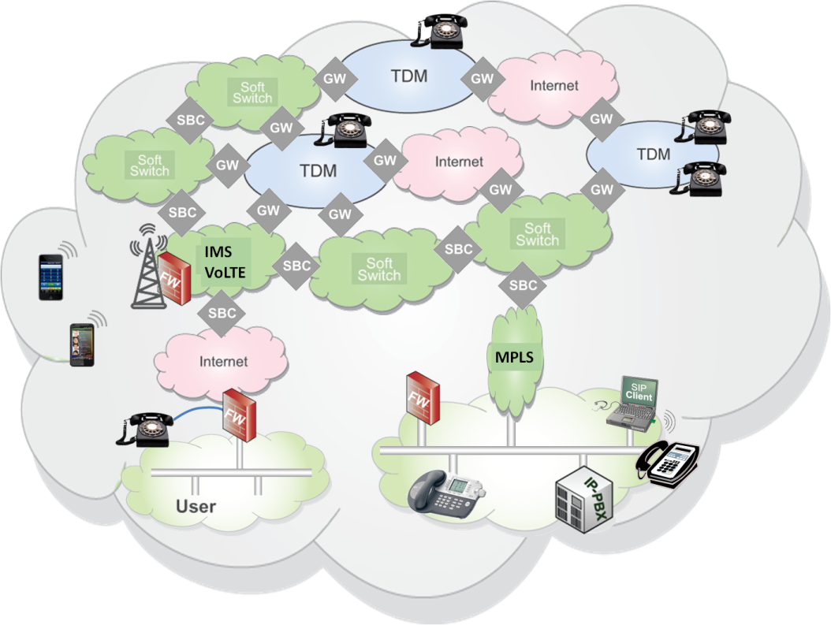
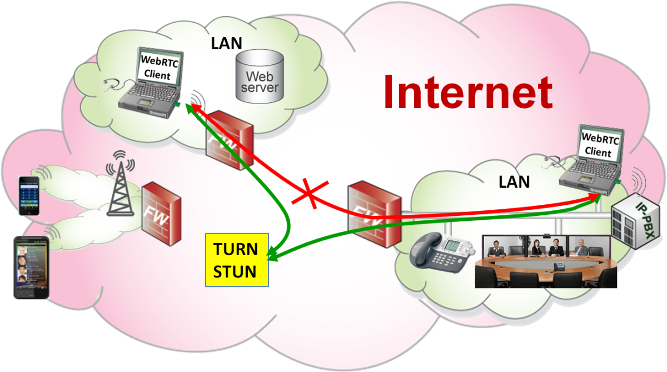
ICE Means There is no WebRTC-SBC
ICE was developed and standardized for SIP, but not used much for SIP…
WebRTC has no SBC-alternative, it is end-to-end (encrypted)
WebRTC Prescribes ICE, which uses STUN & TURN, negotiated in SDP.
Best: WebRTC is end-to-end and does not encourage application specific networks
Worst: The firewalls are unaware of what is being traversed – Or isn’t it?

Slide 13
ICE is Complex - But it Will Work
ICE is complex, but yes, I believe it will work because there are only a handful of browsers. Implementations simply have to be compliant and compatible!
Concerns?
  Local TURN servers required – Or delays?
  Slow – Trickle ICE?
  Bigger and bigger SDP – Watch out!
  Does not penetrate restrictive enterprise firewalls. Tunneling over open TCP ports is no quality option
  Security is otherwise OK. There is Excellent Privacy
  Quality through firewalls unaware of the traffic type?
UDP is required for real-time. Open TCP ports 80 (http) or 443 (https) are no good.
Quality?

Slide 14
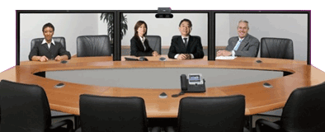

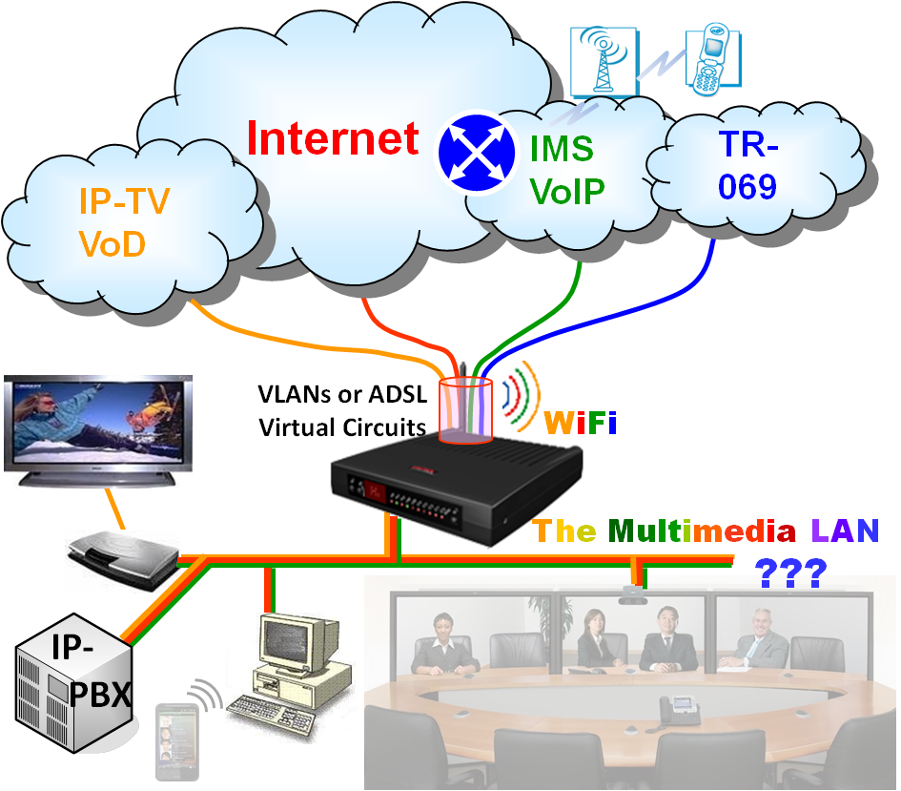
From POTS to Telepresence – A Gigantic Step
WebRTC has the potential of telepresence quality: Opus HiFi sound and VP8 / H.264 HD video
Layer 4 QoS: UDP over TCP is not sufficient
It is NOT “Just About Bandwidth”
  Data crowded networks
  Surf, email, file transfer fill the pipes
Carriers concerned – do advanced networks
  But out comes RJ11 = POTS Quality…
  Still, Internet has the largest bandwidth
  We just need to Prioritize - Level 3 QoS
Pre- AM Radio
3,5 kHz to 20 kHz audio and 3,5 Mbps video
RJ11

Slide 15
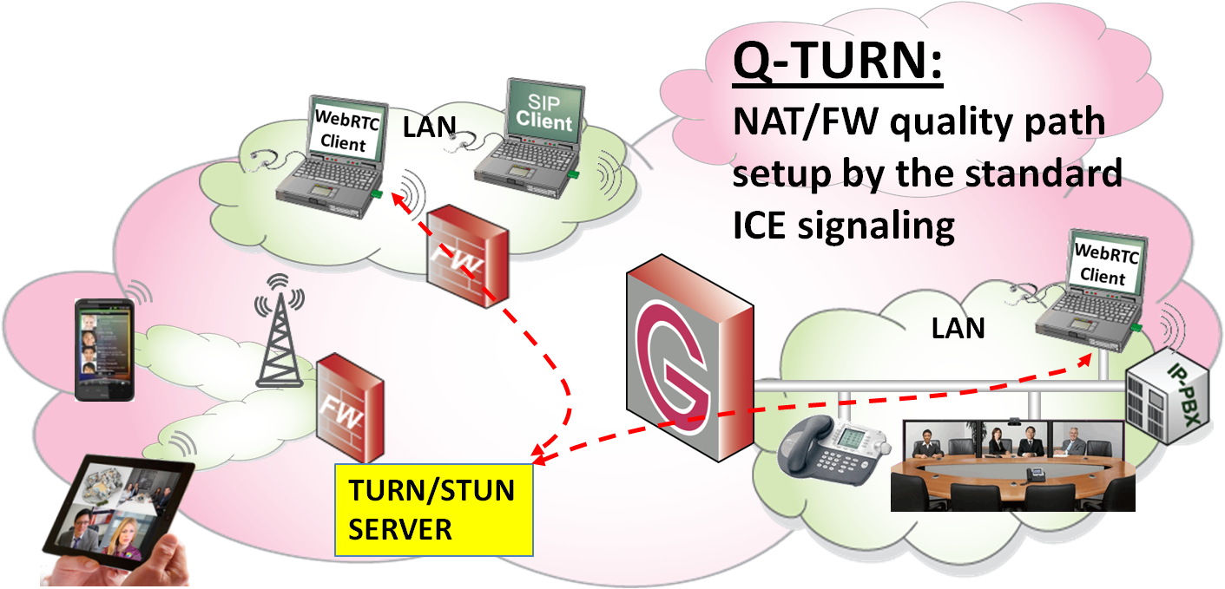
A Novel View on ICE – Q-TURN
Knock-knock; Give my media a Quality Pipe
Regard ICE as a request for real-time traffic through the Firewall. Interpret the STUN & TURN signals in the Firewall
Have the STUN/TURN server functionality IN the Firewall and setup the media flows under control
Security is back in the right place - The firewall is in charge of what is traversing
Enterprise firewall can still be restrictive
Q-TURN
Q-TURN Enables QoS and More:
Prioritization and Traffic Shaping
Diffserve or RVSP QoS over the Net
Authentication (in STUN and TURN)
Accounting – Payload Type is seen

Slide 16







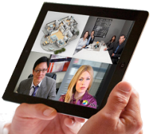






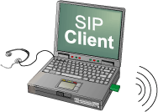



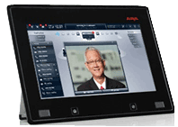


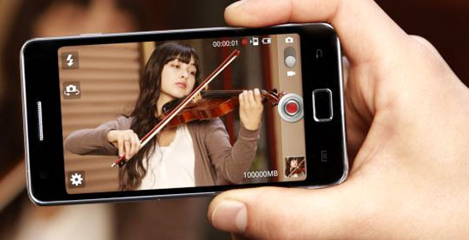
Q-TURN as the Carrier Broadband Delivery
Sell a “WebRTC-Ready” Access!
Why only deliver Best Effort Data?
Quality Traffic - prioritized real-time traffic within the same pipe - is highly valuable, but cost no more bandwidth to produce!
OTT can be more
than data delivery.
Telepresence in
your pocket!
SIP Connect 1.1
Internet+
Q-TURN at the Carrier Demarcation Points
Mobile (replace the DPI behind the Cell Tower)
Enterprise and SMB delivery
Residential delivery – Fits embedded CPEs

Slide 17



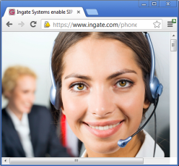


Ingate’s Live Demonstration at Display Table 29
Q-TURN Relies on Standardized ICE
It is for WebRTC and other protocols using ICE
Quality for End-to-end WebRTC
Even for SIP if ICE is used (But our product also includes a SIP proxy based E-SBC)
Transcoding is different – That is a Gateway function
Ingate’s WebRTC – SIP Gateway is a PBX / UC Companion based in Ingate’s SIP Trunking E-SBC
It brings WebRTC into the “PBX / UC Social Network” infrastructure
Company
Web Server
media
WS
LAN
SIP

Slide 18
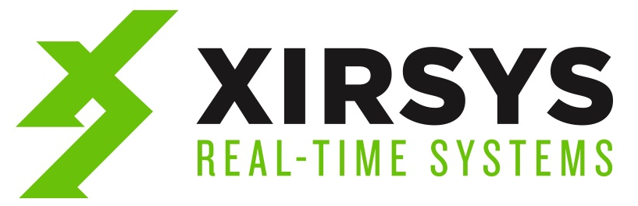
Richard Blakely
CEO
Influxis / XirSys richard@influxis.com
XirSys provides IaaS for WebRTC including TURN server hosting, professional support, client ecosystem, and much more.

Slide 19
WebRTC Streaming Basics
STUN SERVER
P2P
Client A
Client B

Slide 20
TURN Basics
Provides relays for data transfer between participants using NAT traversal
TURN SERVER
Client A
Client B

Slide 21


Streaming Basics
Provides one-to-many and many-to-many transmission of data
Client E
STREAMING SERVER
Client D
Client C
Client A
Client B

Slide 22

TURN for Streaming
Innovation Layer, Transcode &
Package
Record Media
Client E
Client A
TURN SERVER
STREAMING SERVER
Client D
Client C
Client B
Client B

Slide 23
Find Out More
Visit us at: www.xirsys.com
BETA testers, email: beta@xirsys.com
Direct email: richard@xirsys.com

Slide 24
Questions
When is a TURN server required?
What Firewall issues cannot be circumvented?
Do these techniques compromise security and is the proposed firewall combined with the TURN server a solution to that?
Do they allow security to be bypassed?
What kind of Quality improvements could be added considering the TURN server as part of the firewall?
What are the performance and latency issues of a STUN or TURN implementation?

